Slide 1
Data Visualisation 4
2024-2025 Numeric Computing Numpy
by Dr Yuhang Ye

Slide 2
Why Learn Numpy
If you're considering a future career in data analytics using Python, it's almost certain you'll use NumPy. This is true unless you prefer PyTorch for deep learning, which offers similar functionalities. However, many in deep learning still rely on NumPy for numerical computing alongside PyTorch. It's an unusual but common practice.
NumPy serves as the foundation for nearly all CPU-based data analytics and scientific computing tools, such as SciPy, OpenCV, scikit-learn, and pandas.
Within pandas (next section), for instance, data is typically handled using NumPy arrays. Indeed, accessing the `df.values` attribute of a DataFrame will return its underlying NumPy array.

Slide 3
What are the difficulties about Numpy
Fortunately, this is not a neural network course, so we won't be handling very high-dimensional data.
For instance, in video processing using neural network, a typical video segment might have dimensions like [N, T, C=3 (RGB), H, W], whereas standard tabular data usually has just two dimensions [N, C], where N is the number of samples and C is the number of features. This makes visualization of tabular data much simpler.
High-dimensional data can be challenging because processing it with nested for-loops is inefficient and does not effectively utilize multi-core processing.
Techniques like code vectorization, which involve matrix operations or using tools like einops for higher-dimensional arrays, can help achieve parallel processing.
In this course, we may need to manipulate a little high-dimensional data in very simple cases, but it won't be our main focus.
Remember, writing code that is easy to understand is often more valuable than optimizing for speed without adequate documentation, as it simplifies debugging, especially with complex data.

Slide 4
TOC
Numpy Arrays
Bitmap Images
Load and Display Image

Slide 5
Numpy Arrays
Import, Create, and Inspect an Array

Slide 6
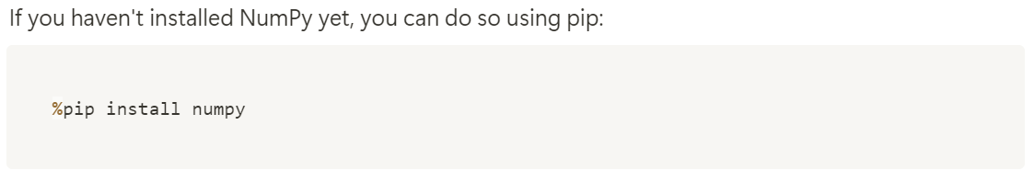
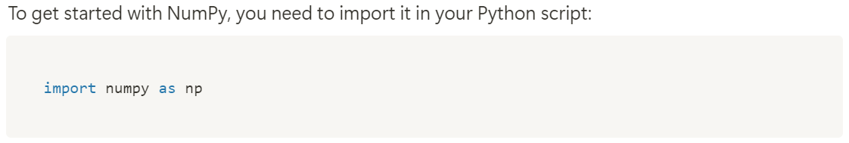
Importing NumPy
It is a convention to short `numpy` into `np` for most python users.

Slide 7
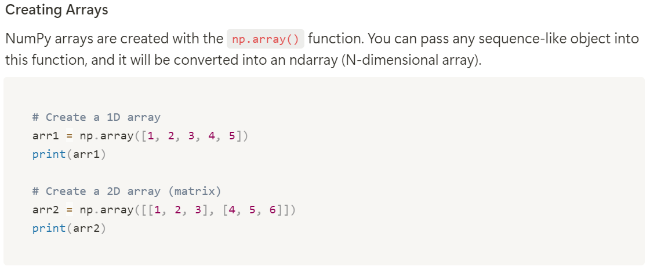
Creating Array
It supports int, uint, float, double, real, complex, by specifying,
arr1 = np.array([1, 2, 3, 4, 5], dtype=np.float64) you can force the array to be double floating array.
see https://numpy.org/doc/stable/reference/arrays.dtypes.html for details.
Usually, we only use the Python’s build-in float (64bits), and int (infinite bits),
While for opencv (cv2) application, you will need to use np.float32 (for most image transformations) and np.uint8 (for image read and save).

Slide 8
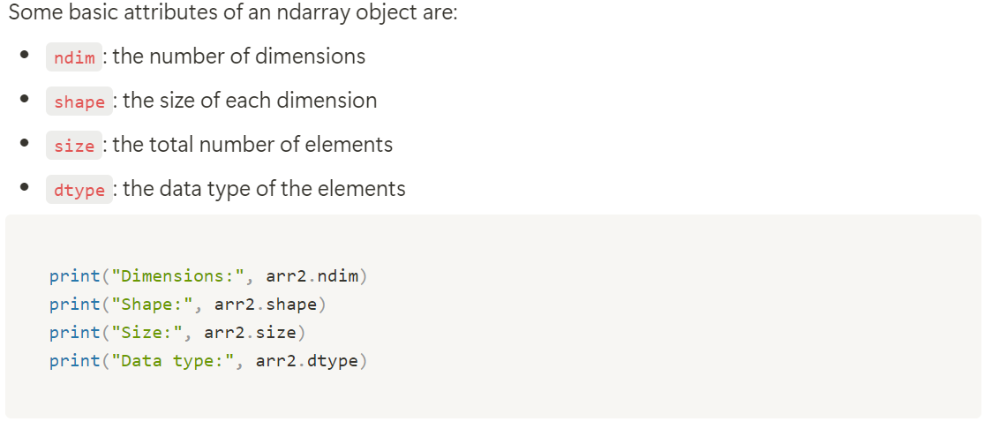
Array Attributes
Dimensions is 2 because it is a 2D array
Shape is [2, 3] because it is 2 row and 3 column
Size is the total number of elements in the array that is 6=2x3
Data type is int64 which is the default in numpy, for int with undefined length.

Slide 9
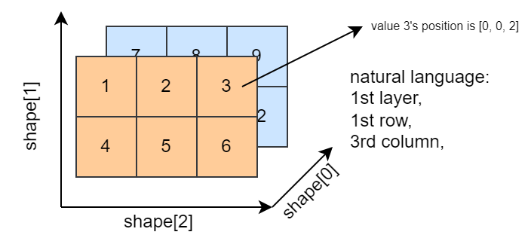
Array Indexing
Array Structure:
The diagram represents a 3D NumPy array with three dimensions: shape[0], shape[1], and shape[2].
The values in the array are arranged across multiple layers. The orange layer represents the first layer, and the blue layer represents the second layer.
Indexing in NumPy:
Axes: NumPy arrays are indexed using the following convention:
shape[0] represents the axis for layers.
shape[1] represents the axis for rows.
shape[2] represents the axis for columns.
Element Access:
Each element in the array is identified by its 3D index in the format [layer, row, column].
For example, in the diagram:
The value 3 is located in the 1st layer (shape[0] = 0), 1st row (shape[1] = 0), and 3rd column (shape[2] = 2), represented by the index [0, 0, 2].

Slide 10
Introduction to NumPy Array Operations
Part A

Slide 11
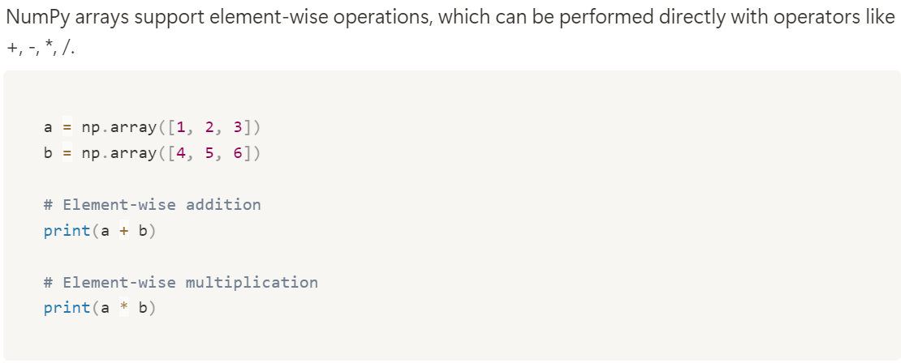
Basic Operations
[1, 2, 3] + [4, 5, 6, 7] will not work, as dim not match

Slide 12
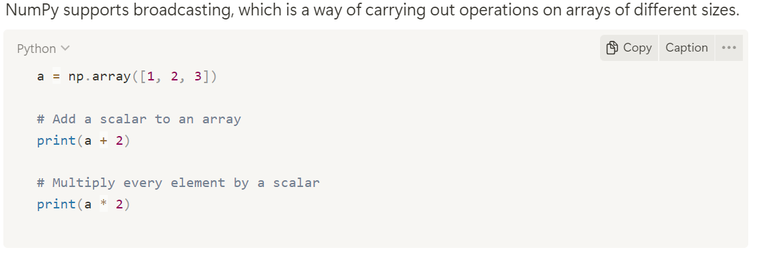
Broadcasting

Slide 13
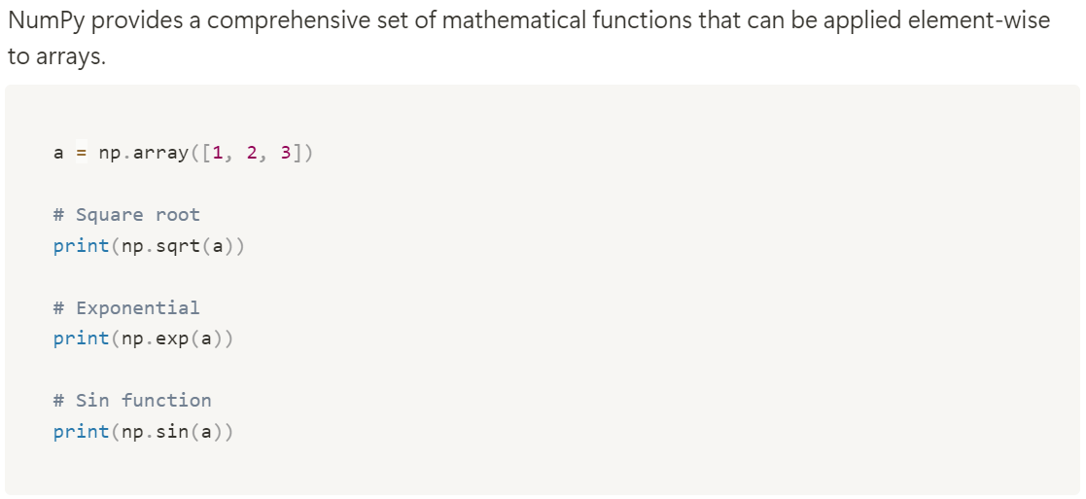
Mathematical Functions

Slide 14
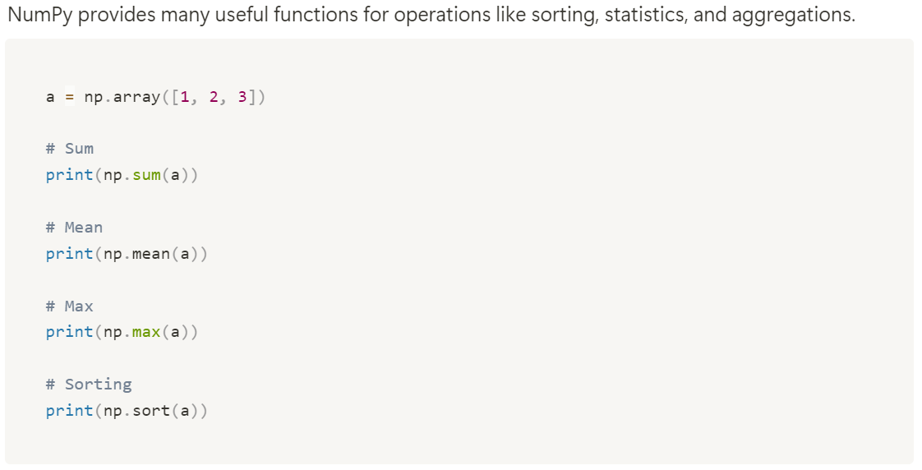
Useful Statistic Functions

Slide 15
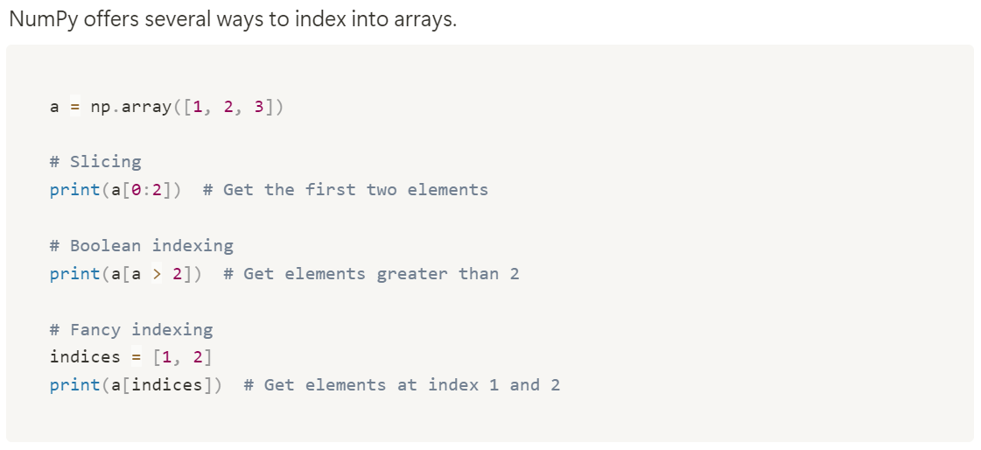
Array Slicing and Indexing

Slide 16
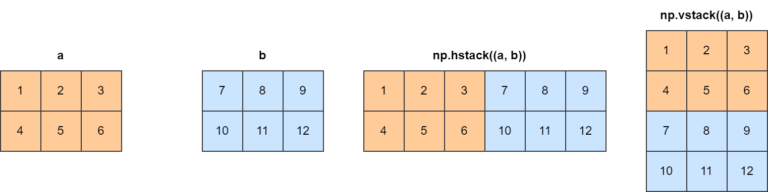
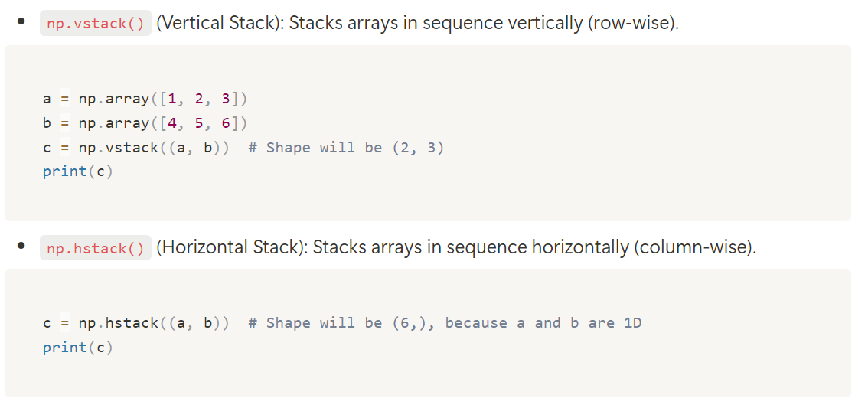
Stacking Arrays
[[1, 2, 3],
[4, 5, 6]]
[1, 2, 3, 4, 5, 6]

Slide 17
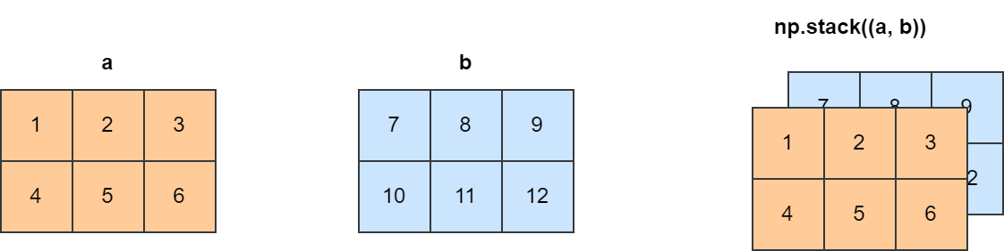
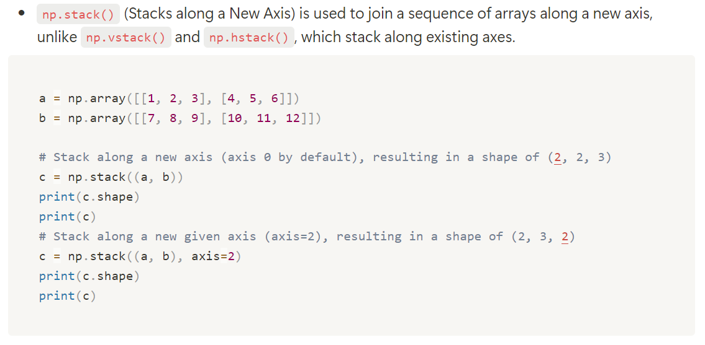
Stacking Arrays

Slide 18
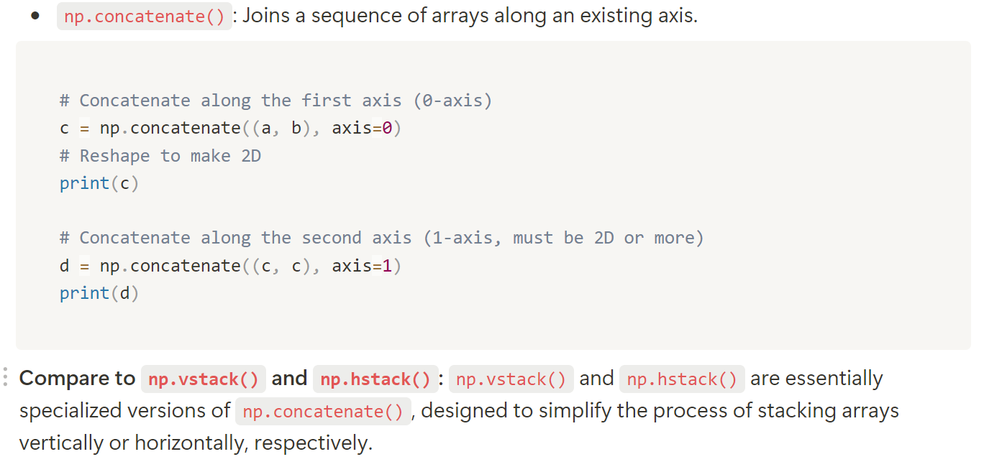
Concatenating Arrays

Slide 19
Introduction to NumPy Array Operations
Part B

Slide 20
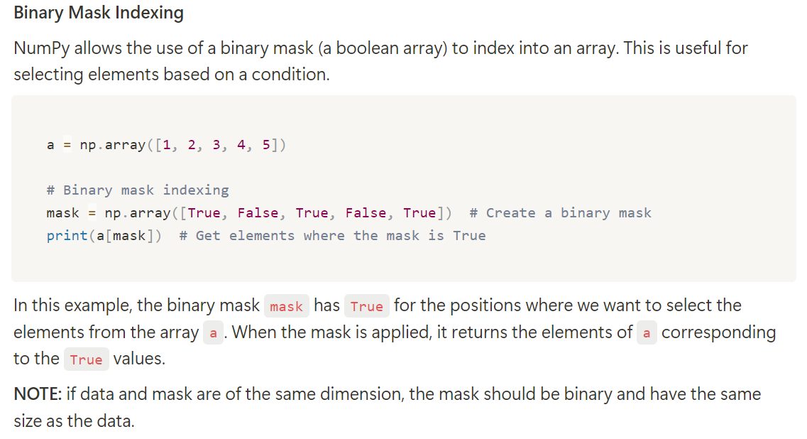
Binary Mask Indexing
Practice: How would you select a with elements larger than 3
a[mask]=[1, 3, 5]

Slide 21
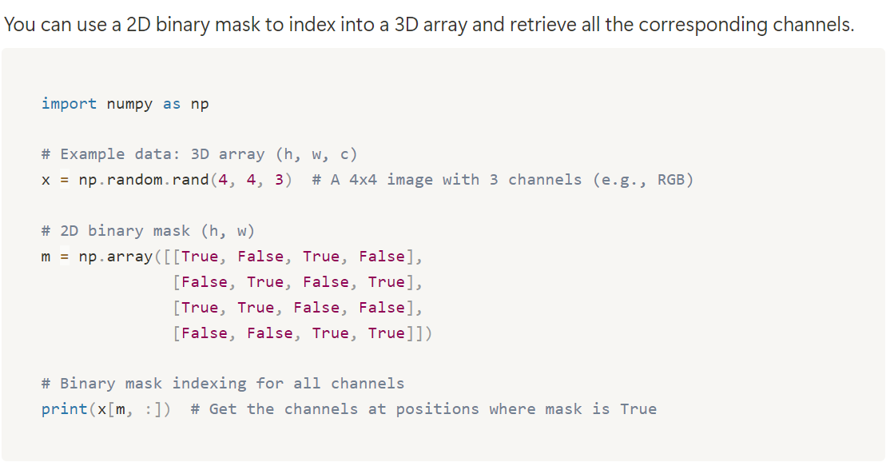
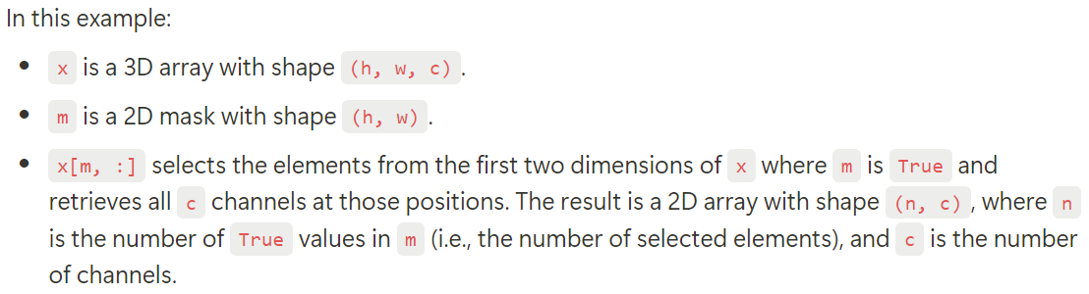
Binary Mask - Indexing on 3D Array (Mask Broadcasting)

Slide 22
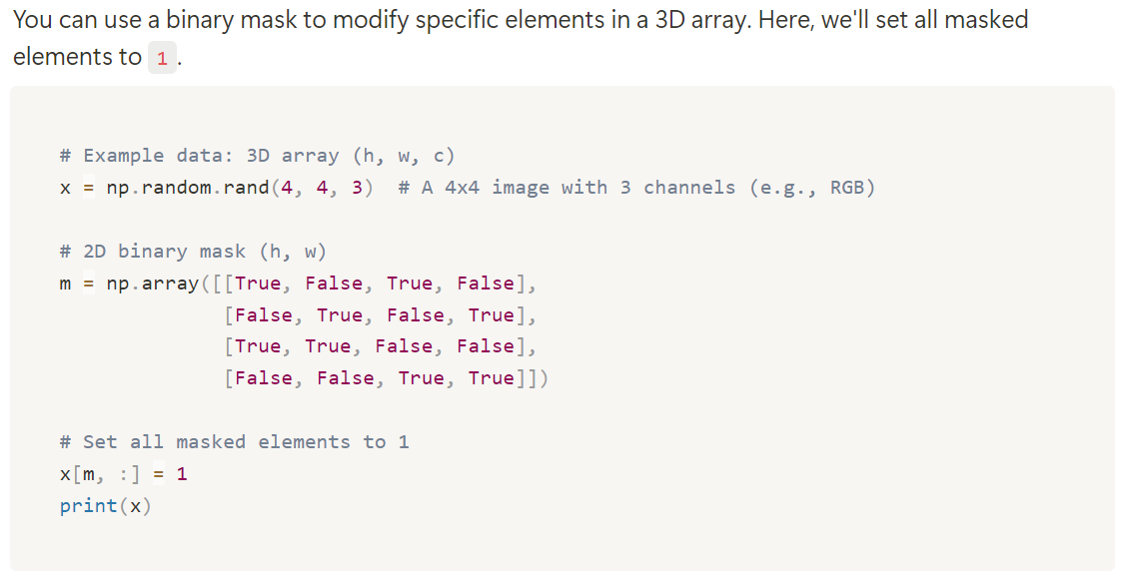
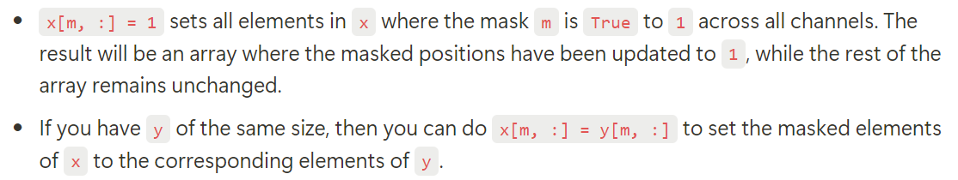
Setting Masked Elements to a Specific Value
You can also assign another array value to this one.

Slide 23
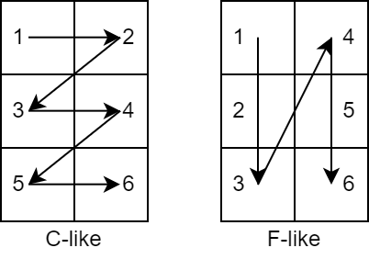
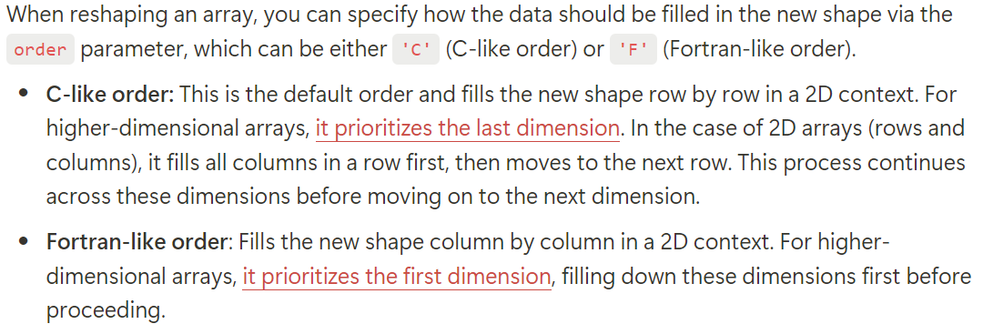
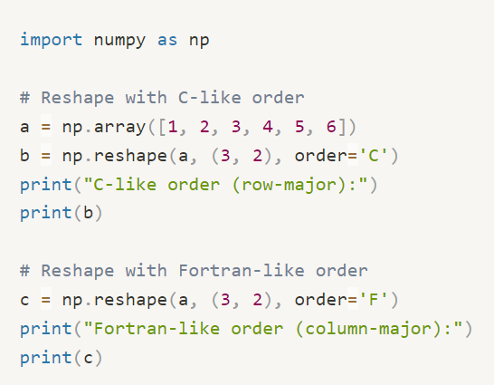
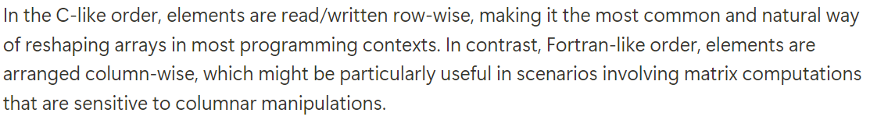
Reshaping with Element Order
In a 2D array, column indices correspond to the last dimension.
'C' means to fill in the last dimension
shape=[R, C]
'F' means to fill in the first dimension

Slide 24
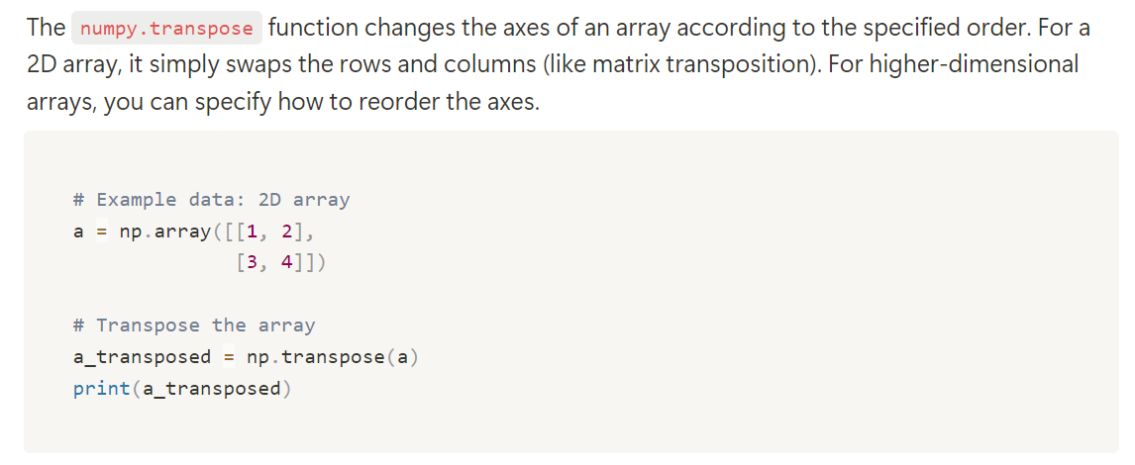
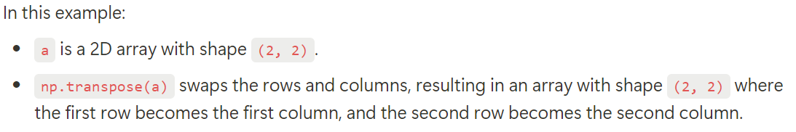
Transpose an Array

Slide 25
Transpose an Array
Result is:
[[1, 3],
[2, 4]]

Slide 26
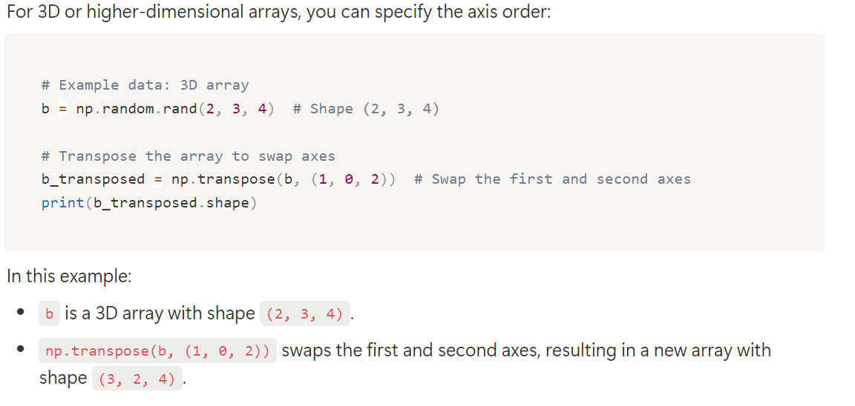
Transpose an Array
In the higher dimension, you do not need understand
how the array transpose in shape, but just remember it as a switch of the dimension indices.
For example,
transpose($[H, W, C]$, (1, 0, 2)) will be [W, H, C]
Place 1 (W) to 0
W is of index 1

Slide 27
Bitmap Image
Images are Pixels, a Pixel is composed of Integers (that is an array)

Slide 28
Why Image
It is easy to view.
It is about bitmap visualization, in fact the heatmap.
It is important knowledge before sequential neural networks (not include in this course.
Audio is another good use case, but it needs headphone mount on your head.
We do not consider vector images (i.e., 2D computer graphics), we may cover that in the geomap visualization.

Slide 29
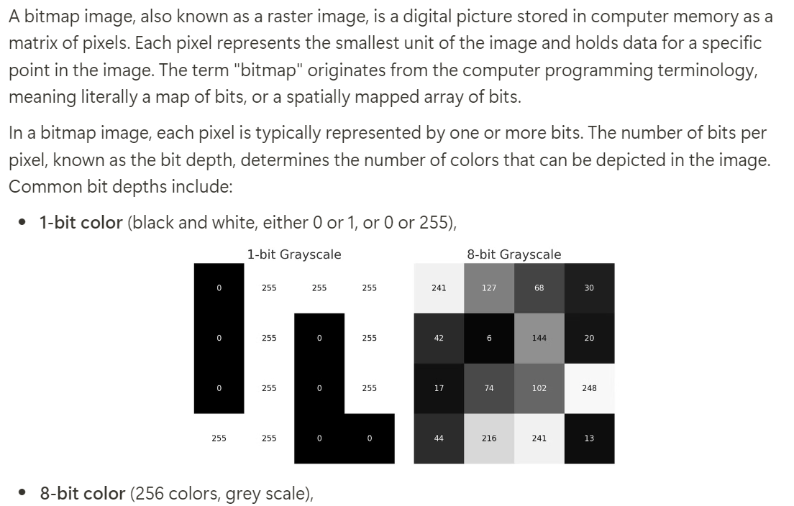
Introduction of bitmap images
In most settings, 1 bit is 0 or 1.

Slide 30
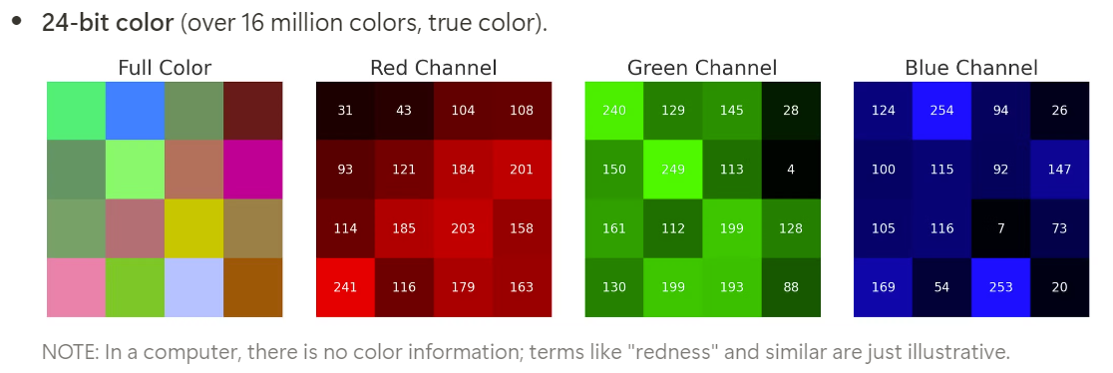
Color Image

Slide 31
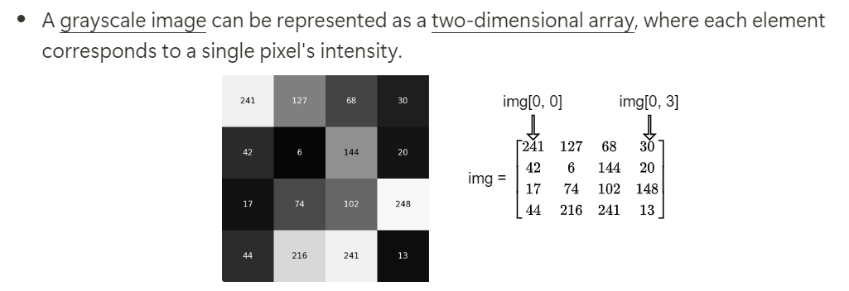
Viewing Bitmaps as Arrays in Python/Numpy

Slide 32
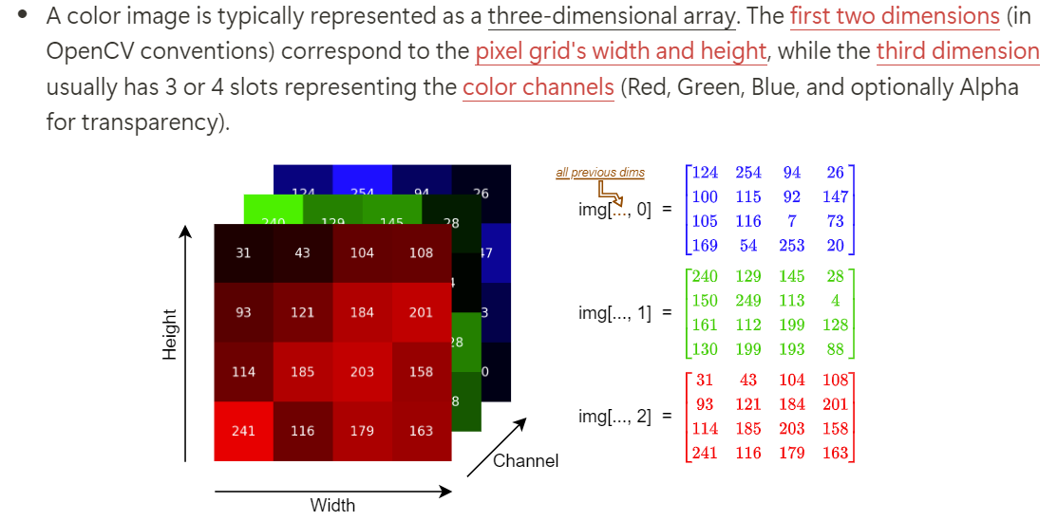
Viewing Bitmaps as Arrays in Python/Numpy
Dimension is [H, W, C]

Slide 33
Load and Displaying Image
In Python is easy

Slide 34
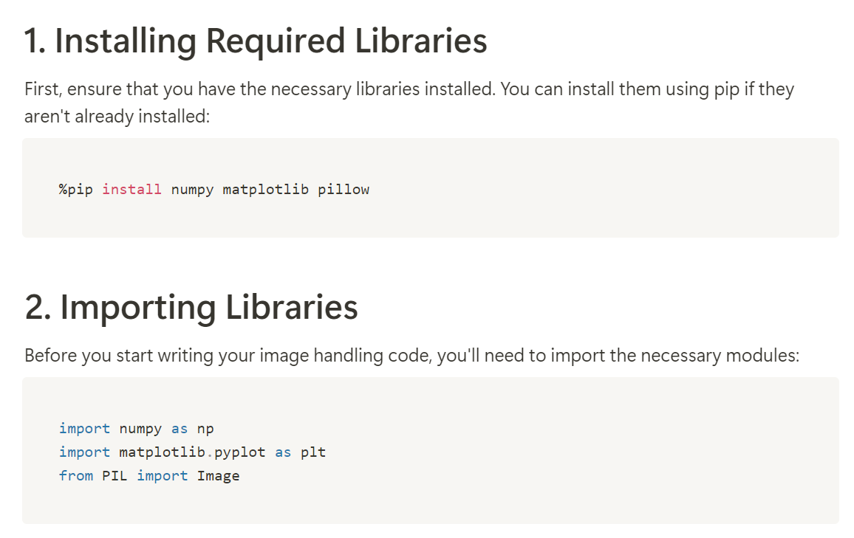
Pre Steps (Installation is needed in Colab)

Slide 35
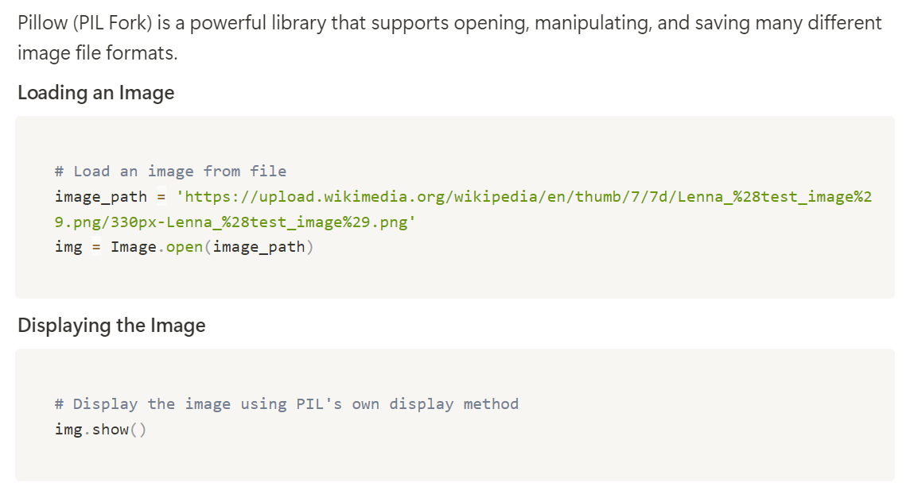
Loading and Displaying Images with PIL (Simple Usages)

Slide 36
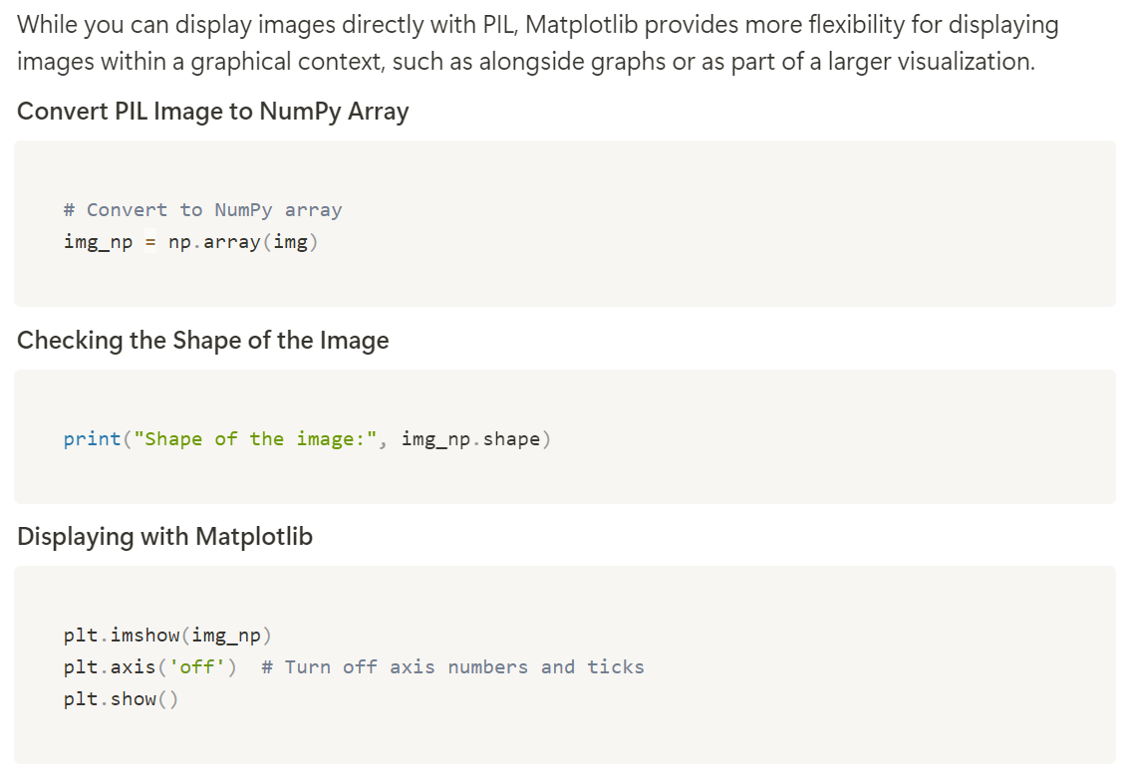
Converting Images for Use with Matplotlib

Slide 37
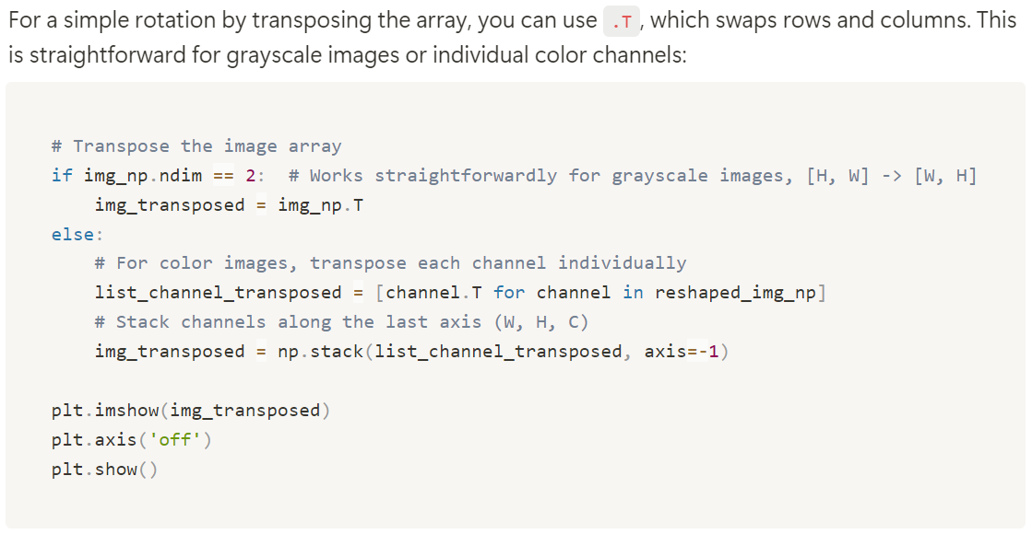
Rotating the Image Using .T
Wrong!
Think about a lambda function for it.

Slide 38
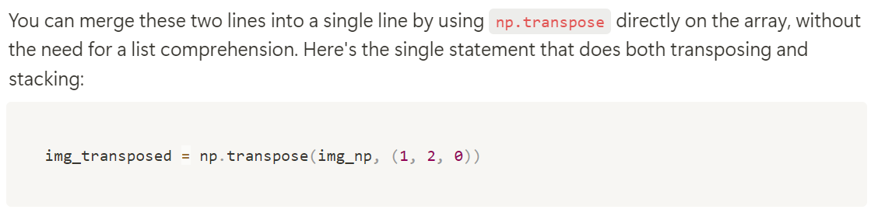
Quiz: Can you think of a simpler way to rotate the image’s height and width?

